Slide 1
ESPRIT — Ecole Superieure Privee d'Ingenierie et de Technologies
End-of-Studies Internship Report · Academic Year 2025 – 2026
Nexus HCM
Intelligent Human Capital Management System
End-of-Studies Internship · ADP ES Tunisie · April – September 2026
Author:
GHARIANI Mohamed Amine · SAE
Host Company:
ADP ES Tunisie · Sana Business Center, Tunis
Company Supervisor:
Ben Fraj Sayed · sayed.ben.fraj@adp.com
Academic Supervisor:
Amani Lamine · ESPRIT
1 / 23

Slide 2
Presentation Outline
01
Company Introduction
08
Methodology
Context & host organization
Agile Scrum & sprints
02
Project Context
09
Key Features
What is HCM?
Module showcase
03
Problem Statement
10
Security
Pain points identified
JWT & RBAC design
04
Existing Solutions
11
Database Design
Market comparison
Entity model
05
Proposed Solution
12
Testing
Nexus HCM overview
Validation results
06
System Architecture
13
Conclusion
3-tier design
Achievements & next steps
07
AI Integration
Smart HR Engine
2 / 23

Slide 3

Host Company — ADP ES Tunisie
Company Details
Sector
IT / HR Solutions
Activity
HR Platform Development
ADP — Automatic Data Processing
Location
Tunis, Tunisia
1M+ clients · 140+ countries · Founded 1949, Roseland, NJ, USA
Email
ADP.es@adp.com
ADP ES Tunisie — Sana Business Center, Boulevard de l'Environnement, Tunis
Phone
+216 71 110 606
Technology & Engineering Center for the MENA region
Contributes to the development of global HR software platforms
Supervisor
Ben Fraj Sayed
3 / 23

Slide 4
What is Human Capital Management?
"Human Capital Management (HCM) is a set of practices and tools that organizations use to recruit, develop, manage, and retain employees, transforming the workforce from a cost center into a strategic competitive advantage."
👥
⚙️
📊
People
Processes
Data & Insights
Employees, their skills, career paths, experience and potential
Onboarding, leave, attendance, payroll, performance cycles
Real-time analytics to drive strategic HR decisions
4 / 23

Slide 5
The Problem
Current state of HR management in many enterprises
"Managing HR in large enterprises is still manual, fragmented, and inefficient — leading to wasted time, data inconsistencies, and poor employee experience."
🗂️
No Centralized Database
✉️
Manual Leave Approval
📋
Paper Attendance Sheets
Employee data lives in spreadsheets and email threads, leading to duplication and inconsistency across teams.
Requests sent by email with no workflow, no tracking, and slow response times from managers.
No real-time visibility on who is present, absent, or working overtime. Impossible to audit.
🔓
No Access Control
🚪
Poor Employee Onboarding
🔍
No Audit Trail
Sensitive payroll and performance data is accessible to anyone with a shared folder link.
New hires receive credentials through insecure channels, with no automated account provisioning.
No log of who did what. Zero accountability or compliance traceability for HR decisions.
5 / 23

Slide 6
Study of Existing Solutions
Competitive analysis of current HR management approaches
Feature
Spreadsheets
Standalone Tools
Enterprise Suites
Nexus HCM
Centralized Data
❌ None
⚠️ Partial
✅ Yes
✅ Yes
Leave Workflow
❌ Email
⚠️ Basic
✅ Full
✅ Full
Attendance Tracking
❌ Paper
⚠️ Limited
✅ Yes
✅ Digital
Role-Based Access
❌ None
⚠️ Basic
✅ Advanced
✅ 3-Level RBAC
Onboarding Auto.
❌ Manual
⚠️ Partial
✅ Yes
✅ Email Token
AI Reports
❌ None
❌ None
⚠️ Add-on
✅ Built-in GPT-4
Recruitment
❌ None
❌ None
⚠️ Extra module
✅ Full pipeline
Cost
✅ Free
⚠️ Moderate
❌ Very High
✅ Custom / Low
6 / 23

Slide 7
Nexus HCM: The Proposed Solution
One Platform · Three Roles · All HR Operations
🔴 HR Admin
Nexus HCM
🔵 Employee
Full system access
Self-service portal
› Employee lifecycle & onboarding
› Personal profile & documents
🟣 Manager
› Department & org management
› Leave request submission
Team supervision
› Leave, advance approvals
› Team performance dashboard
› Salary advance requests
› Job board & recruitment
› Leave & advance approvals
› Daily clock-in / clock-out
› AI report generation
› Weekly attendance calendar
› System configuration
› Performance evaluations
7 / 23

Slide 8
System Architecture
Decoupled three-tier architecture with external AI integration
Presentation Layer — Angular 17 (Port 4200)
HR Admin Dashboard
Manager Dashboard
Employee Portal
Public Careers
HTTP / REST / JSON
Business Logic Layer — Spring Boot 3 / Java 21 (Port 8085)
🤖
OpenAI
GPT-4
REST Controllers
Service Layer
JPA Repositories
Spring Security/JWT
AI calls
JDBC / JPA / Hibernate
Data Layer — MySQL 8 (XAMPP)
Employee/Dept Tables
Leave/Advance Tables
Job/Application Tables
8 / 23

Slide 9
AI Integration: Smart HR Engine
🤖 Nexus HCM integrates OpenAI GPT-4 to transform raw HR data into actionable intelligence
Two AI-powered features built into the platform
📊 AI-Powered HR Report Generation
📄 Intelligent CV Screening
1
HR Admin clicks "Generate Report"
1
Candidate submits application with CV and cover letter
2
Backend aggregates: headcount, leave rates, attendance, dept breakdown
2
Backend extracts text from CV and cover letter
3
Metrics bundled into a structured prompt for GPT-4
3
AI compares content against job requirements
4
GPT-4 returns natural-language executive HR summary
4
Returns match score 0–100 with skill highlights
5
Report displayed instantly in the dashboard
5
Score badge appears on each application row
Implemented ✅
Implemented ✅
Powered by OpenAI GPT-4 API — integrated via Spring Boot RestTemplate / HTTP Client
9 / 23

Slide 10
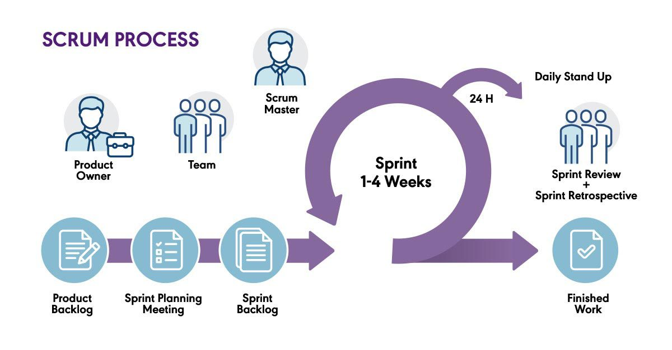
Development Methodology Agile Scrum
Iterative delivery with continuous supervisor feedback
Why Agile Scrum?
⚡ Iterative delivery of functional modules each sprint
💬 Continuous feedback from company supervisor
🔄 Adapts quickly to evolving requirements
✅ Each sprint ends with a working, tested increment
Sprint Planning · 01 April – 30 September 2026
S0
S1
S2
S3
S4
01/04–14/04
15/04–30/04
01/05–31/05
01/06–31/07
01/08–30/09
Setup & Architecture
Auth & Employees
HR Operations
Recruitment & AI
Polish & Deploy
10 / 23

Slide 11
Key Features — HR Administration (1/3)
👥 Employee Management
🌳 Org Chart — Collapsible Tree
[ Screenshot: Employee List & Create Form ]
[ Screenshot: Org Chart, Expanded View ]
Full CRUD lifecycle · Department assignment · Activation email · Role management
Recursive tree algorithm · Collapse/expand subtrees · Quick manager reassignment
📋 Leave & Salary Advance Management
📈 Performance Evaluation
[ Screenshot: Leave Requests Tab ]
[ Screenshot: Performance Module ]
PENDING → APPROVED/REJECTED · Badge notifications · Reviewer notes per request
Configurable campaigns · Per-employee scoring · Period-based history tracking
11 / 23

Slide 12
Key Features — Recruitment & AI (2/3)
💼 Job Board (HR Admin Panel)
🌐 Public Careers Page
[ Screenshot: Job Board, Position List ]
[ Screenshot: Careers Page, Position Cards ]
DRAFT → OPEN → CLOSED lifecycle · Hiring manager assignment · Application pipeline
No login required · Department/type filters · Opens detail in new tab · CV upload (5 MB)
🤖 AI HR Report Generation
📄 Intelligent CV Screening
[ Screenshot: AI Report in HR Dashboard ]
[ Screenshot: Application List with AI Scores ]
One-click generation · GPT-4 natural-language summary · Workforce insights
Match score 0–100 · Skill highlights · Gap analysis · Score badge on each row
12 / 23

Slide 13
Key Features — Manager & Employee Portals (3/3)
📊 Manager Dashboard
⚙️ Dynamic System Configuration
[ Screenshot: Manager Dashboard ]
[ Screenshot: System Config Panel ]
Team overview · Leave approvals · Weekly attendance calendar · Performance reviews
Live branding (logo, colors, name) · Propagates to all pages in real time
🙋 Employee Self-Service Portal
🔔 Attendance & Clock System
[ Screenshot: Employee My-Dashboard ]
[ Screenshot: Attendance Tracker ]
Profile management · Leave requests · Salary advance requests · Clock-in/out
Digital check-in / check-out · Per-employee daily log · Manager team calendar view
13 / 23

Slide 14
Security Architecture — JWT & RBAC
Browser
Angular
JwtFilter
Controller
MySQL
POST /api/auth/login
POST /api/auth/login (forward)
findByEmail()
Employee entity
JWT token + role + name
Store in localStorage, redirect to /dashboard
🔐 Role-Based Access Control: HR Admin → /dashboard | Manager → /manager-dashboard | Employee → /my-dashboard
14 / 23

Slide 15
Technical Highlights
🔐 Security
⚡ Architecture
🤖 AI & Data
✓ Stateless JWT tokens
✓ Angular 17 standalone components
✓ OpenAI GPT-4 via REST (HTTPS)
✓ BCrypt password hashing
✓ Spring Boot 3 layered pattern
✓ CV base64 storage (LONGTEXT)
✓ Role-based endpoint protection
✓ RESTful stateless API design
✓ Workforce metrics aggregation
✓ CORS configuration per origin
✓ Dynamic CSS variable injection
✓ Activation token (UUID, one-time)
✓ Audit trail logging (all actions)
16 / 23

Slide 16
Development Timeline — April to September 2026
Sprint 0
Sprint 1
Sprint 2
Sprint 3
Sprint 4
01/04 – 14/04
15/04 – 30/04
01/05 – 31/05
01/06 – 31/07
01/08 – 30/09
Environment setup
JWT authentication
Org chart (collapsible)
Job board (HR panel)
Manager dashboard
Architecture design
Role-based routing
Leave workflow
Public careers page
Employee portal
Database modeling
Employee CRUD
Attendance tracking
CV upload feature
System config
Requirements validation
HR Admin dashboard
Salary advances
AI integration
Testing & GitHub deploy
17 / 23

Slide 17
Testing & Validation
Multi-level testing strategy applied across all sprints
10/10
12/12
0
8/8
API Endpoints
Functional Scenarios
TypeScript Errors
System Tests
Selected API Test Results
Key Functional Scenarios
Login valid credentials
200 + JWT
✅
✅ Login + role-based redirection (3 roles)
✅ AI CV screening score displayed
✅ Employee create + activation email
✅ Generate AI HR report successfully
Login wrong password
401
✅
✅ Org chart collapse/expand nodes
✅ Live branding config propagates
Get employees (no token)
403
✅
✅ Leave request full approval cycle
✅ Built-in test runner: 8/8 PASS
Create employee (manager)
403
✅
✅ Salary advance full review cycle
✅ TypeScript: 0 compilation errors
Publish job position
200
✅
✅ Publish job → visible on /careers
Apply with CV (public)
200
✅
✅ Apply with CV → stored in database
18 / 23

Slide 18
Conclusion: What Was Delivered
🔧 Platform
📦 Modules
🤖 AI Features
✓ Spring Boot 3 + Angular 17
✓ 10+ functional HR modules
✓ GPT-4 HR report generation
✓ JWT + 3-Level RBAC
✓ Full recruitment pipeline
✓ Intelligent CV screening
✓ MySQL + Hibernate DDL
✓ Collapsible org chart
✓ Match score 0–100 badge
✓ RESTful stateless API
✓ Dynamic config system
✓ Workforce metrics aggregation
📁 github.com/amine2zz/ADP · 6-month internship · ADP ES Tunisie · April – September 2026
Full-stack platform · 10+ modules · AI integrated · Deployed on GitHub
19 / 23

Slide 19
Future Perspectives & Roadmap
What comes next for Nexus HCM
💰
Payroll Module
📱
Mobile Application
📈
Real-Time Analytics
Automated payroll calculation based on attendance records, leave deductions, and configured salary parameters.
React Native companion app for employee clock-in/out, leave requests, and push notifications on iOS/Android.
Chart-based workforce dashboards (Chart.js/ECharts) with live KPIs, trend analysis, and exportable reports.
☁️
Cloud Deployment
🧠
Advanced AI Features
🔔
Push Notifications
Docker containerization + deployment on AWS/Azure for production availability and horizontal scalability.
Employee churn prediction, skill gap analysis, automated performance coaching suggestions using ML models.
Real-time in-app and email alerts for approvals, rejections, contract renewals, and HR broadcast messages.
20 / 23

Slide 20
Live Demo
Platform walkthrough — localhost:4200
[ Login Page — Role Redirection ]
[ HR Admin Dashboard Overview ]
[ Org Chart — Collapse / Expand ]
[ Careers Page + AI Score Badge ]
21 / 23
Backend running on port 8085 · Angular on port 4200 · MySQL via XAMPP

Slide 21
Project Summary at a Glance
6
5
10+
Months of Development
Agile Sprints
HR Modules Delivered
9
43
2
JPA Entities
REST API Endpoints
AI Features
22 / 23

Slide 22
Thank You
Questions & Answers
Author
Host
Period
GHARIANI Mohamed Amine
SAE · ESPRIT
ADP ES Tunisie
Ben Fraj Sayed
April – September 2026
6 months
📁 github.com/amine2zz/ADP
Nexus HCM — Intelligent Human Capital Management System · 2025–2026
23 / 23

